Slide 1
Ensuring Project Success with SpiraTeam & Rapise

Slide 2
Agenda
Overview of Inflectra
SpiraTeam - Managing the Agile Software Lifecycle
SpiraPlan – What is That?
Robotic Process Automation with Rapise
Questions

Slide 3
Overview of Inflectra

Slide 4
Who am I?
Originally from Swansea, Wales
Twin City of Mannheim
Learned to Program Computers at age 8, BBC Micro 32K Basic ☺
Moved to Boston, MA in 1998
Worked at Sapient in Boston, LA, DC
Inflectra Started in 2006

Slide 5
Who Are We?
Software company with HQ in Washington, DC, USA
Sales Offices and Partners around the world
5,000+ customers, 80,000+ users, in 100+ countries
Founded in 2006, grown organically since then
No Venture Capital or Private Equity

Slide 6
Our Core Values
Build for Our Users, Not for Wall Street
We Just Get It Done
Family and Life Flexibility
Enabling “Second Acts”

Slide 7
Our Partnership with PTA & DATIS
2010 - Started with a call - Dennis Haßlöcher and Adam
2011 – Partnership between PTA and Inflectra Signed
2016 – DATIS Hosting for EU Customers
2017 – Inflectra User Summit in Mannheim
2018 - Inflectra.de created, supported by DATIS
+
+

Slide 8
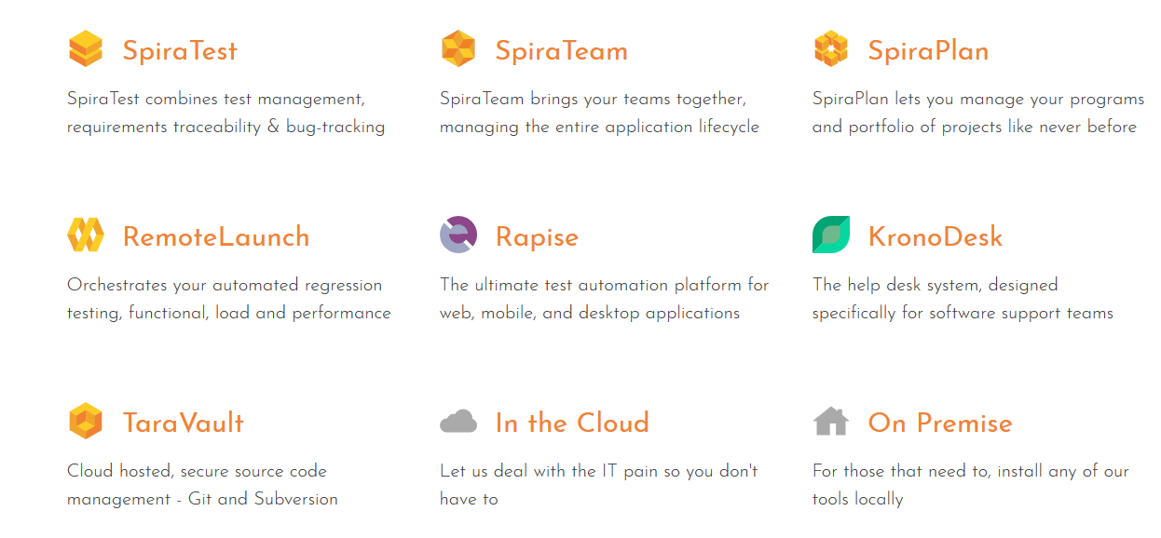
The Inflectra Ecosystem

Slide 9
How the Products Fit Together…
KronoDesk®
IT Support & Help Desk Ticketing
SpiraPlan®
Agile Program & Portfolio Management
SpiraTeam®
Application Lifecycle Management (ALM)
SpiraTest®
Requirements, Test Management
& Bug Tracking
TaraVault® - Source Code Management
Rapise®
Test Automation (Web, GUI, Services)

Slide 10
Representative Customers
The following are some of our customers:
Energy & Industrial
Financial & Business Services
Government
Information Technology
Healthcare & Bio-Technology
Telecommunications
Retail & Consumer Goods
Transportation & Hospitality

Slide 11
SpiraTeam
Managing the Agile Software Lifecycle

Slide 12
The Agile Approach
Fast 2-week iterations / sprints
Requirements, testing and development fully integrated
Traditional Waterfall Methodology
Requirements
Gathering
Business Design
Technical Design
Systems Development
Unit
Testing
Integration
Testing
Acceptance
Testing (UAT)
Release Complete
Agile Methodology
Limited Upfront Planning
Release #1
Release #2
Release #3
Release #4
It 1
It 2
It 3
It 4
It 5
It 6
It 7
It 8
It 9
It 10
It 11
It 12
Release Complete
Iteration N
Iteration Planning
Development, Continuous Integration, Unit Testing, Functional & Acceptance Testing

Slide 13
SpiraTeam = Dev + Test + Plan
Development
Testing
Planning & Management

Slide 14
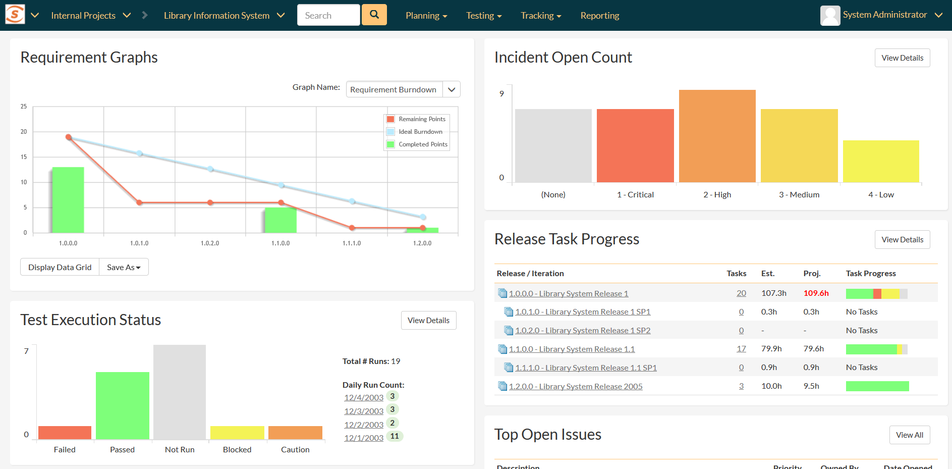
Project & Program Dashboards

Slide 15
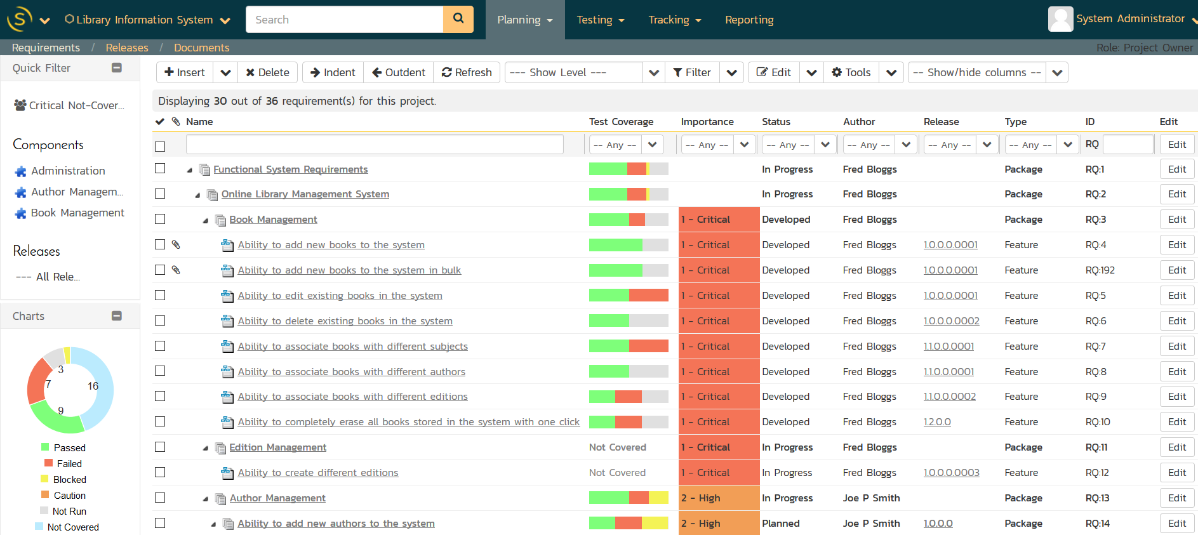
Requirements & Test Traceability

Slide 16
Requirements Traceability

Slide 17
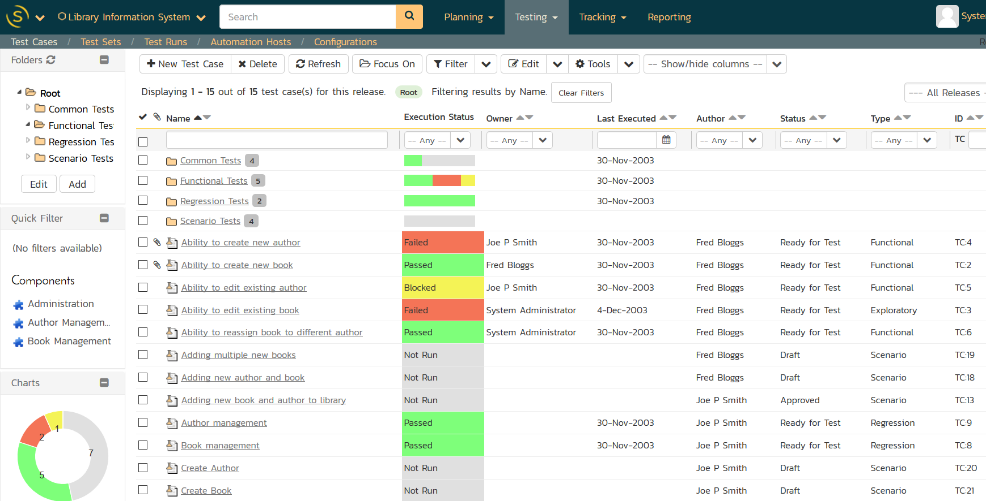
Test & Quality Management

Slide 18
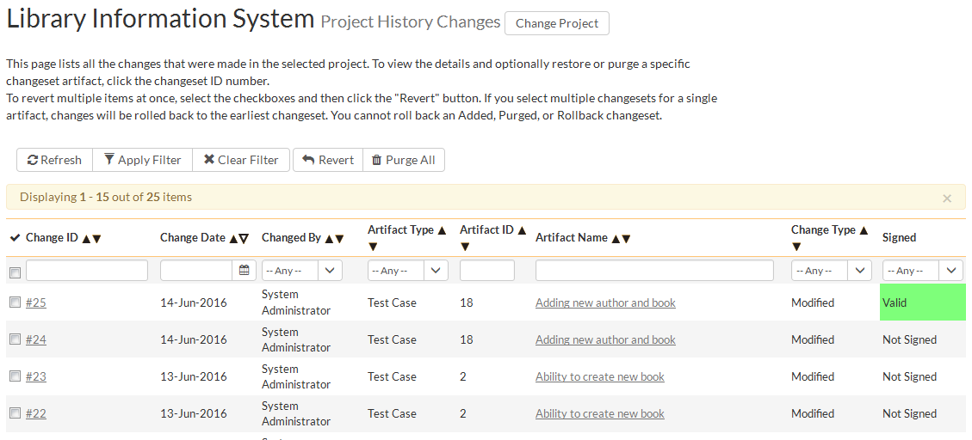
Audit Logging & Trail

Slide 19
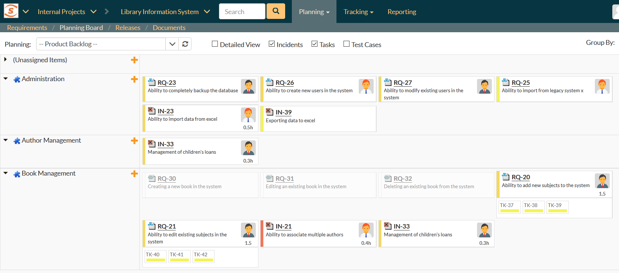
Speed and Agility with Traceability

Slide 20
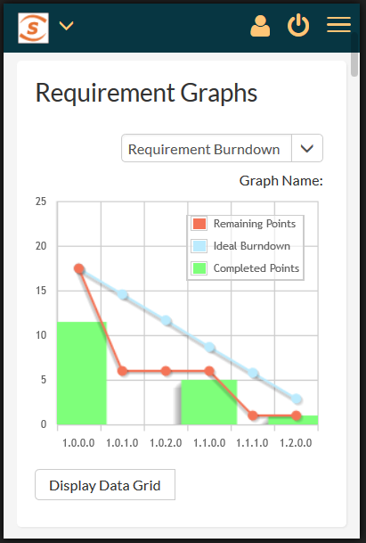
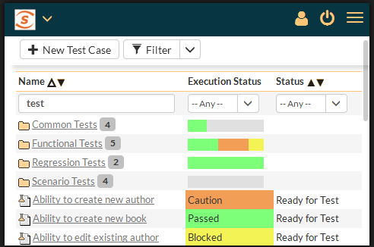
Fully Mobile Responsive
Working “on-the-go”, computer, phone or tablet

Slide 21
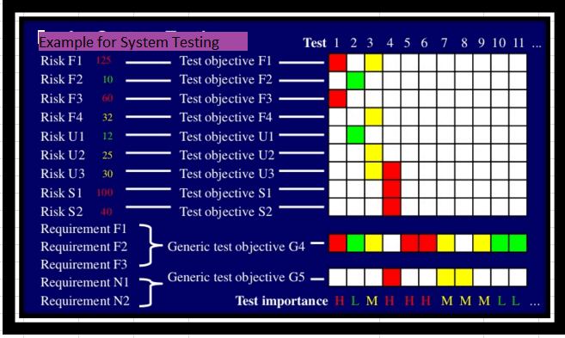
AI-Based Testing?
System will monitor metrics around requirements
Complexity, priority, task scope
System will review prior testing activities
Unstable tests, priority, # defects
System will suggest test plans automatically

Slide 22
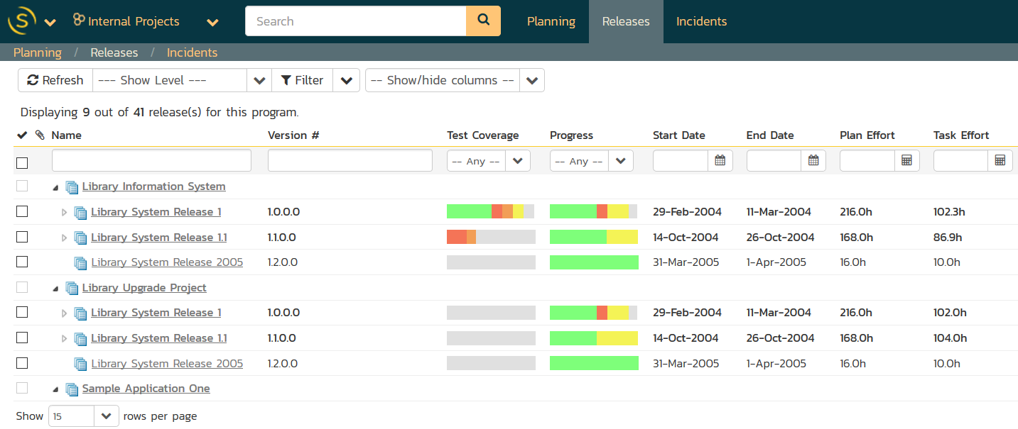
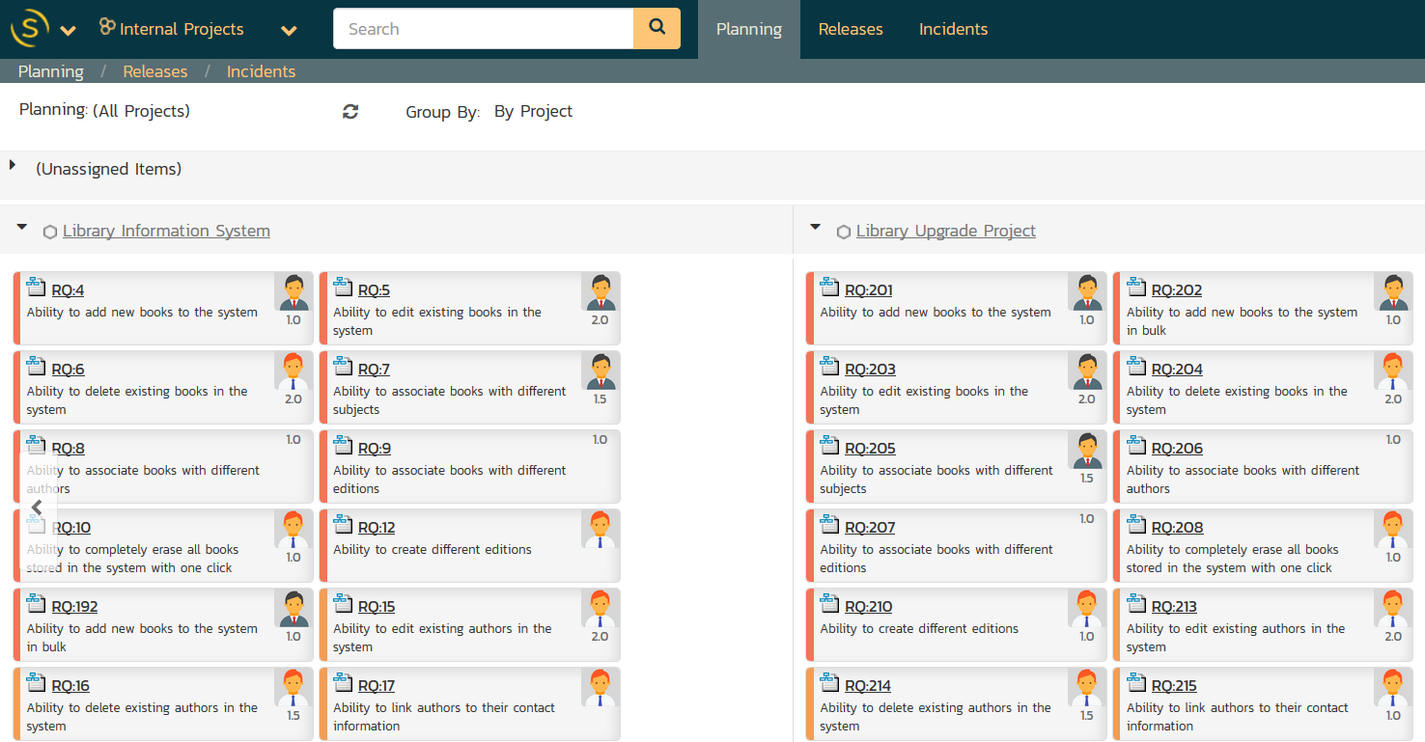
Program Management – SpiraPlan

Slide 23
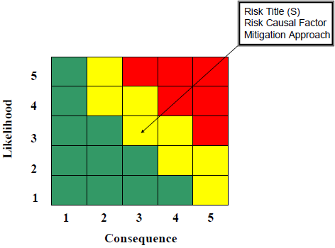
SpiraPlan - Enterprise Risk Management
Project Level Risk Management
Track Risk Severity & Probability
Program Level Risk Management
Assign overall risk status to projects and programs
Associations
Ability to link Risks to other artifacts, with ‘mitigation’ sub-artifact available

Slide 24
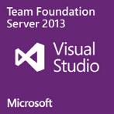
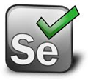
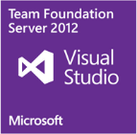
SpiraTeam Integration Options
SpiraTeam comes with a wide variety of plugins and connectors:
Developer IDEs
Unit Test Frameworks
Build Servers
Bug-Tracking Tools
Modelling Tools
Functional Testing Tools
Source Code Management
Performance Testing Tools

Slide 25
Robotic Process Automation (RPA)
Using Rapise for RPA Projects

Slide 26
Robotic Process Automation - RPA
RPA – is a software for automatic manipulation of PC’s user interface.
RPA software can do what a real user can do and more.

Slide 27
What RPA Can Do
Save time
Repetitive tasks
24/7
Save budget
Work autonomously
Analyze Process
Integrate legacy systems
large volumes of data
for employees

Slide 28
RPA Benefits
Fast & Cheap Implementation
Easy to Support
Local & Remote Scheduled & On Demand Execution
Data Access Control at UI Level
Uses Existing IT Systems

Slide 29
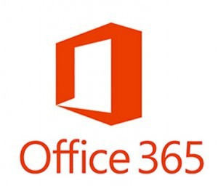
Supports Multiple Platforms & Technologies
Web Applications
Mobile Applications
Cross-Platform Technologies
Windows Applications
Desktop Applications
Web Applications
Unit Test Frameworks
Integrations

Slide 30
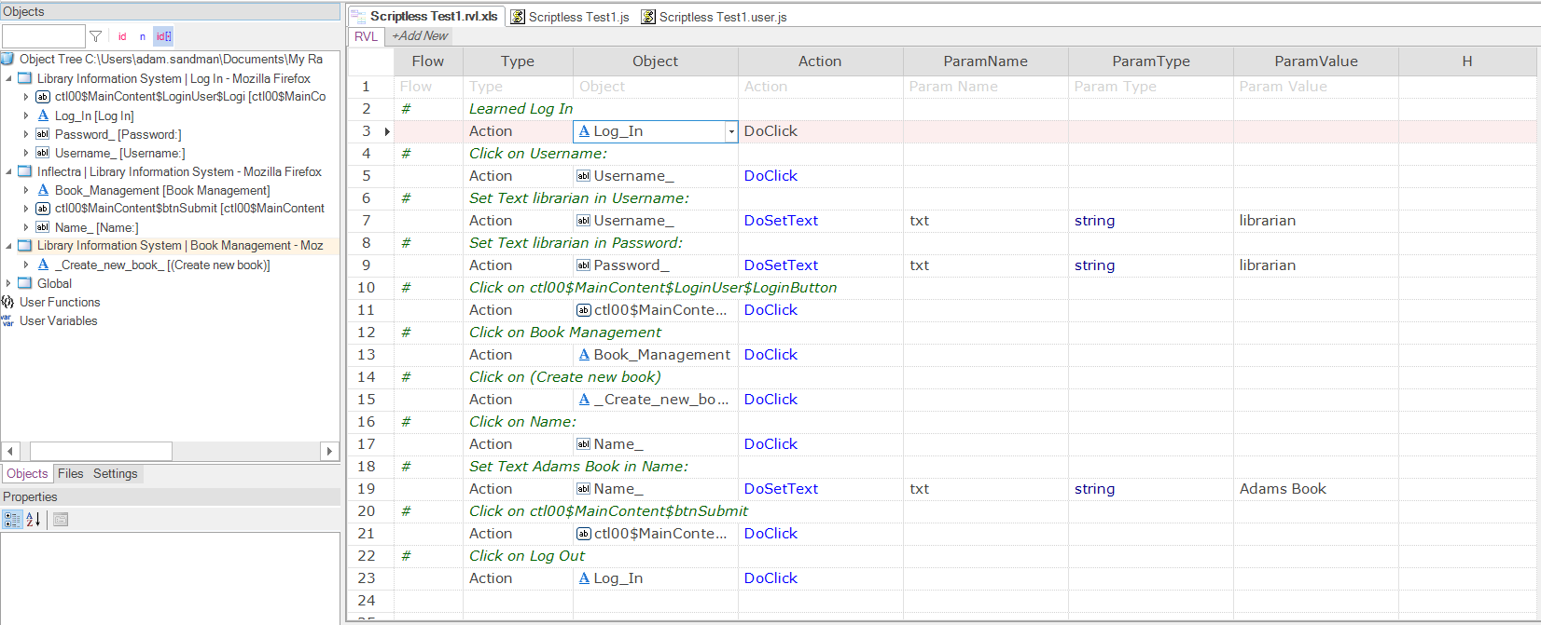
Rapise Visual Language (RVL)
Easier to use by analysts vs. programmers
Easier to maintain.

Slide 31
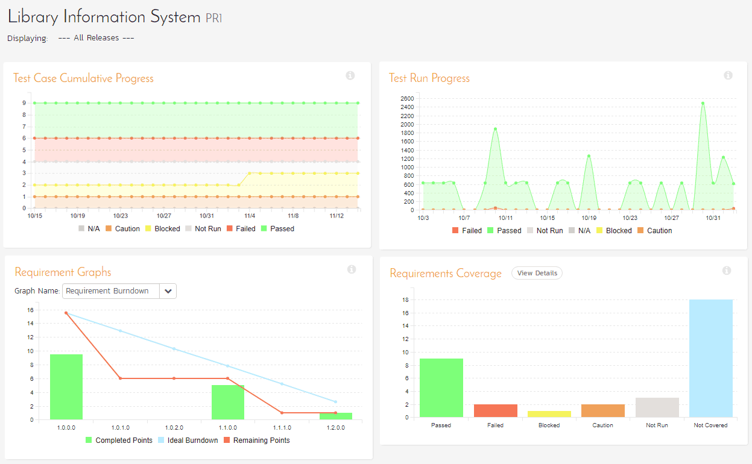
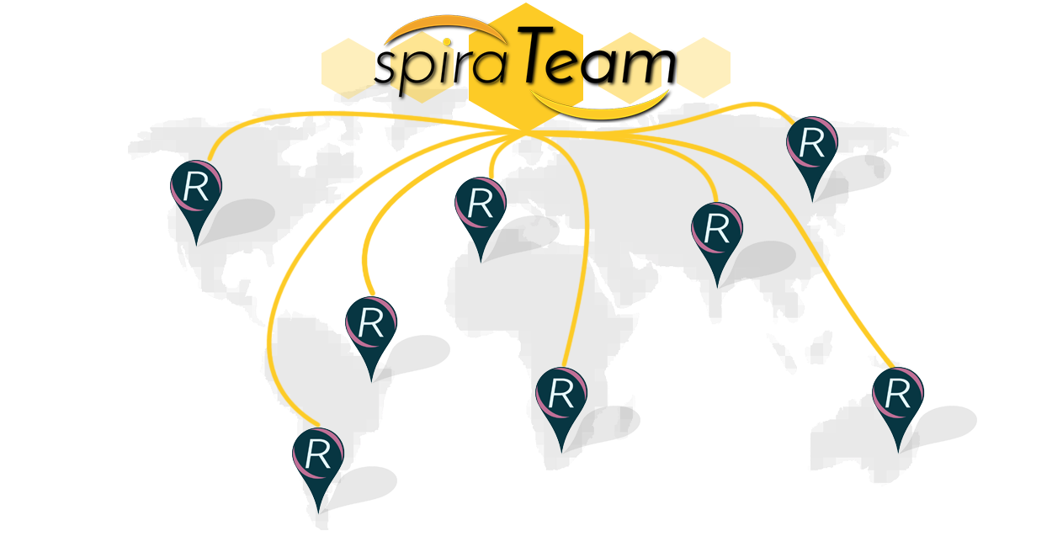
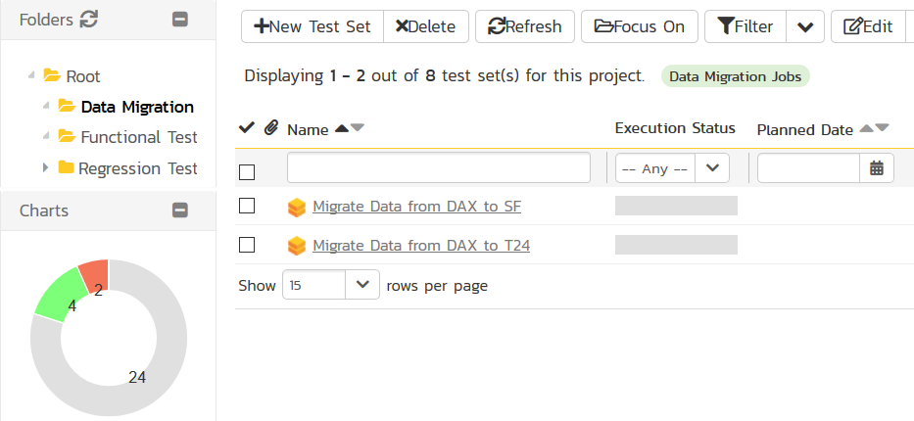
Process Orchestration with SpiraTeam

Slide 32
RPA Scenarios & Tasks
Fill a form based on data in external file
Create a record from incoming email
Import data from a spreadsheet or third-party system
Web scraping
Screen scraping
Terminal automation

Slide 33
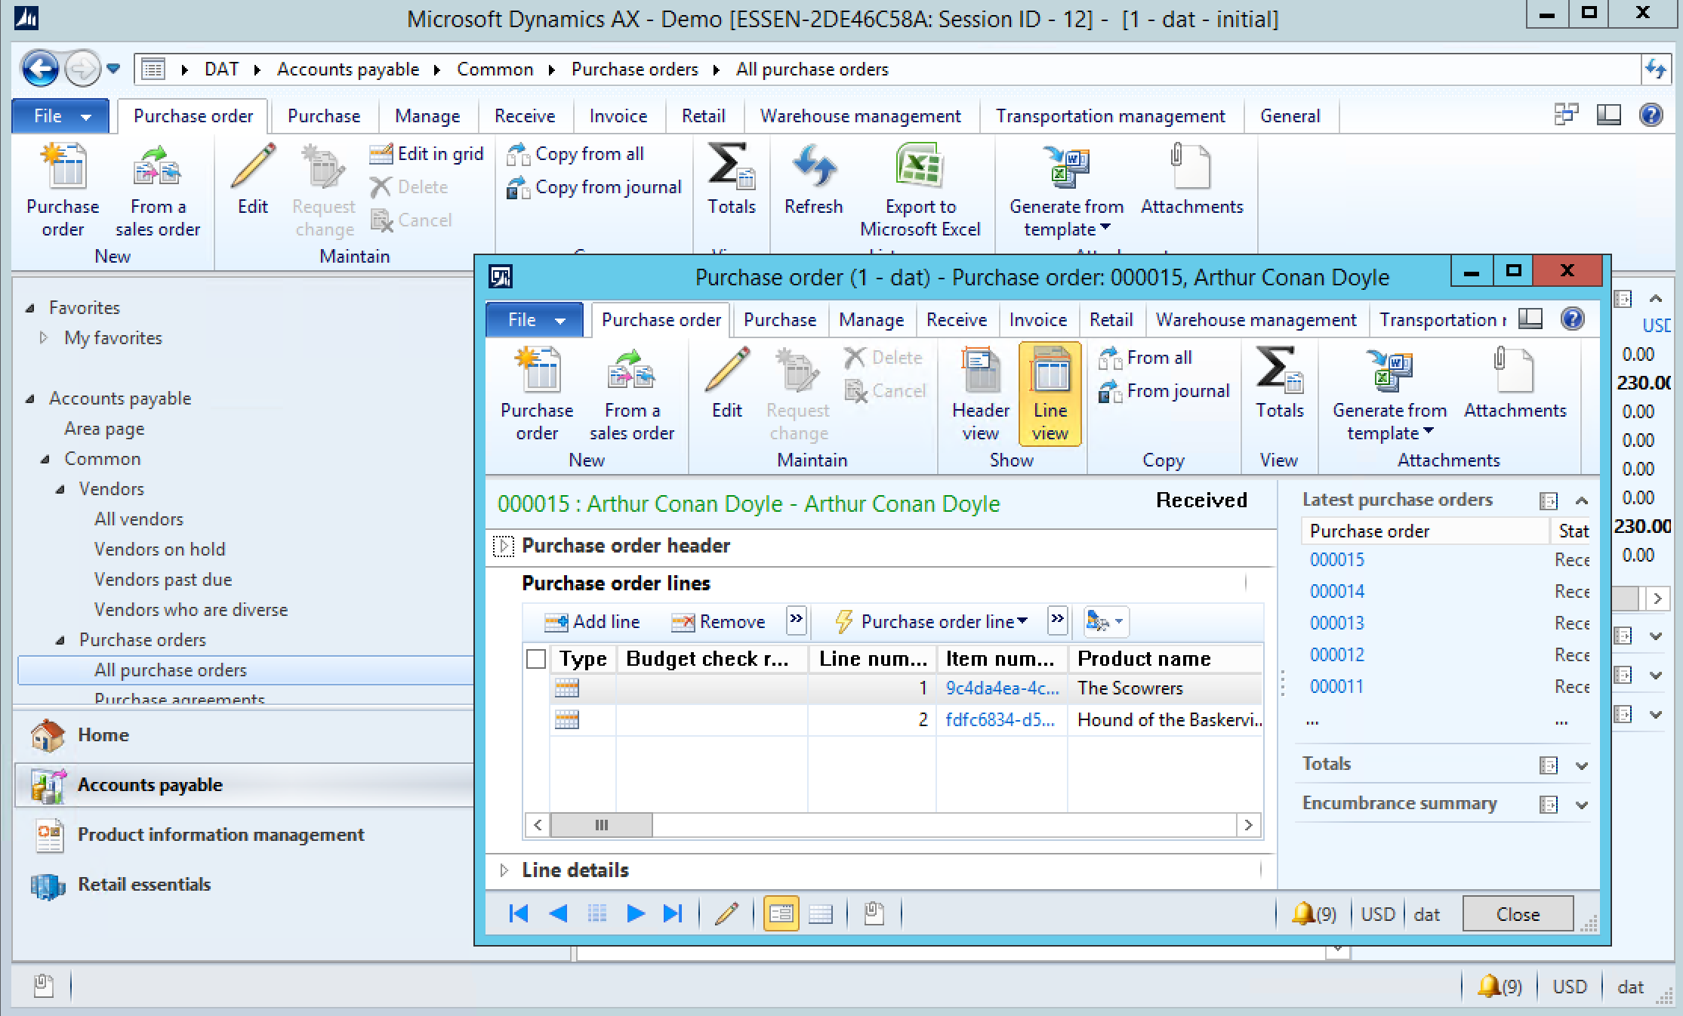
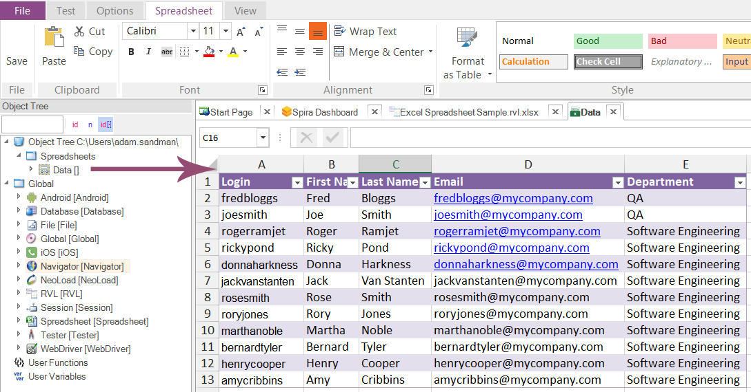
Example Use Case
Importing categories, vendors and products from Excel spreadsheet
(see https://youtu.be/L_2ibVvPTJA)

Slide 34
Questions ?

